Slide 1
Abstract
This project explores Machine Learning-based Predictive Maintenance (PdM). Using sensor data, ML models forecast equipment failures, optimize maintenance schedules, and reduce downtime. Insights are supported by experiments on predictive.csv, a Jupyter notebook, and Power BI visualizations, with literature survey guidance from the 2025 review paper.

Slide 2
Introduction
Predictive Maintenance is a core strategy of Industry 4.0. It transitions industries from reactive to proactive maintenance by leveraging real-time sensor data and AI. Traditional methods such as run-to-failure and preventive maintenance are less efficient compared to ML-driven PdM approaches.

Slide 3
Literature Survey
The 2025 systematic review highlighted:
- ML techniques (Random Forest, XGBoost, LSTM, CNN).
- Common datasets: CMAPSS, MIMII, SECOM, AI4I 2020.
- Challenges: Data imbalance, interpretability, scalability.
- Future directions: Digital twins, hybrid modeling, explainable AI, federated learning.

Slide 4
Algorithms and Modules
Implemented models in the Jupyter Notebook:
- Random Forest (RF)
- XGBoost
- Support Vector Machines (SVM)
- Artificial Neural Networks (ANN)
Modules include preprocessing, feature engineering, model training, and evaluation with metrics such as accuracy, precision, recall, F1-score, and RMSE.

Slide 5
System Architecture
Architecture integrates:
1. Data ingestion (CSV sensor logs).
2. Preprocessing (missing values, normalization).
3. ML models for fault detection and Remaining Useful Life (RUL) prediction.
4. Visualization through Power BI dashboards.
5. Feedback loop for maintenance scheduling.

Slide 6
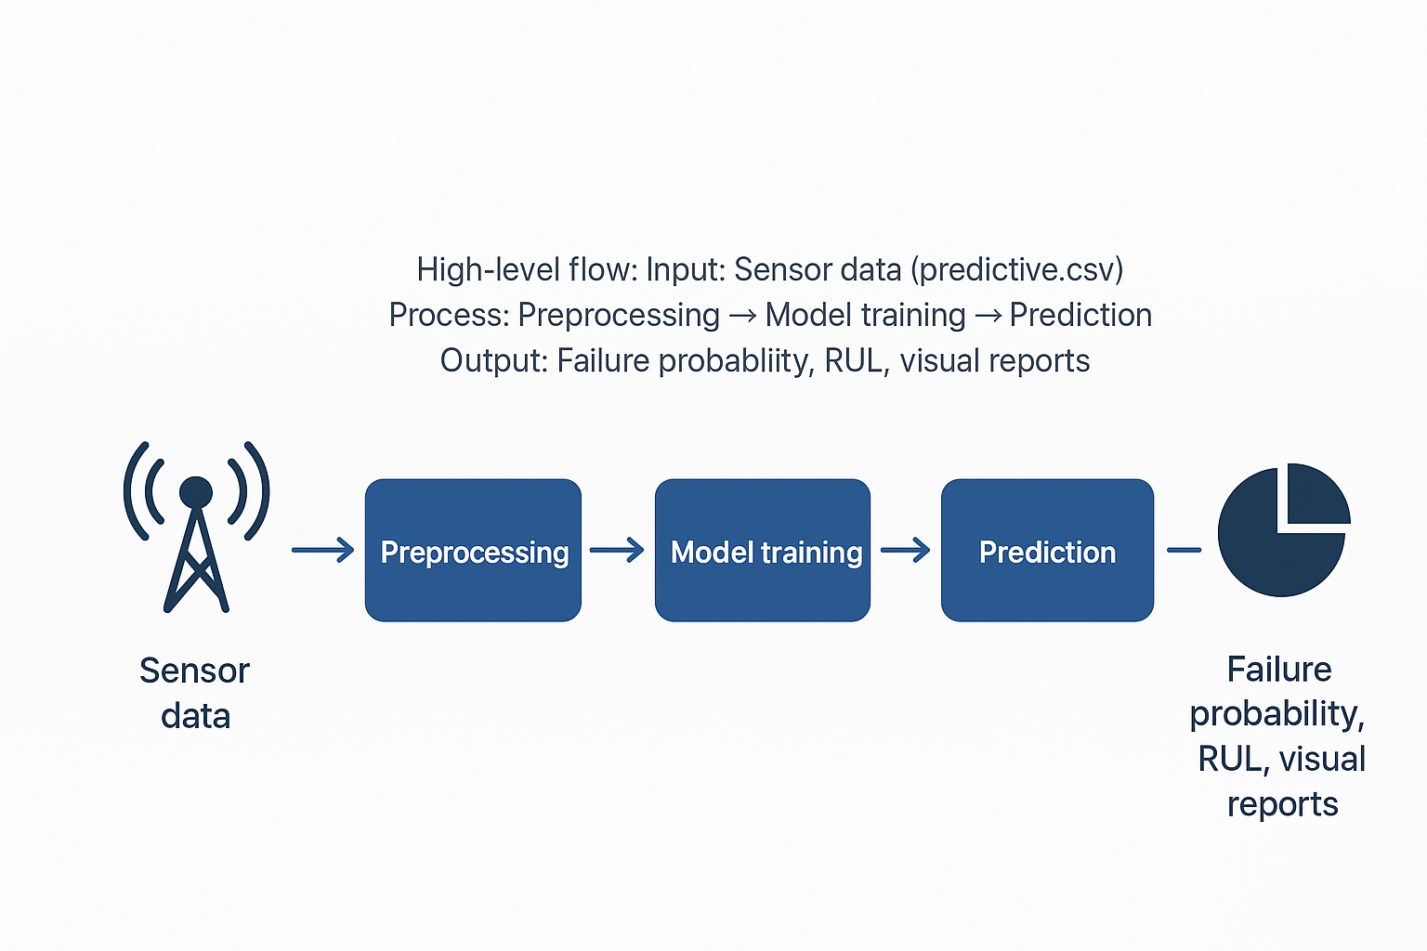
Data Flow Diagram - Level 0
High-level flow:
Input: Sensor data (predictive.csv)
Process: Preprocessing → Model training → Prediction
Output: Failure probability, RUL, visual reports.

Slide 7
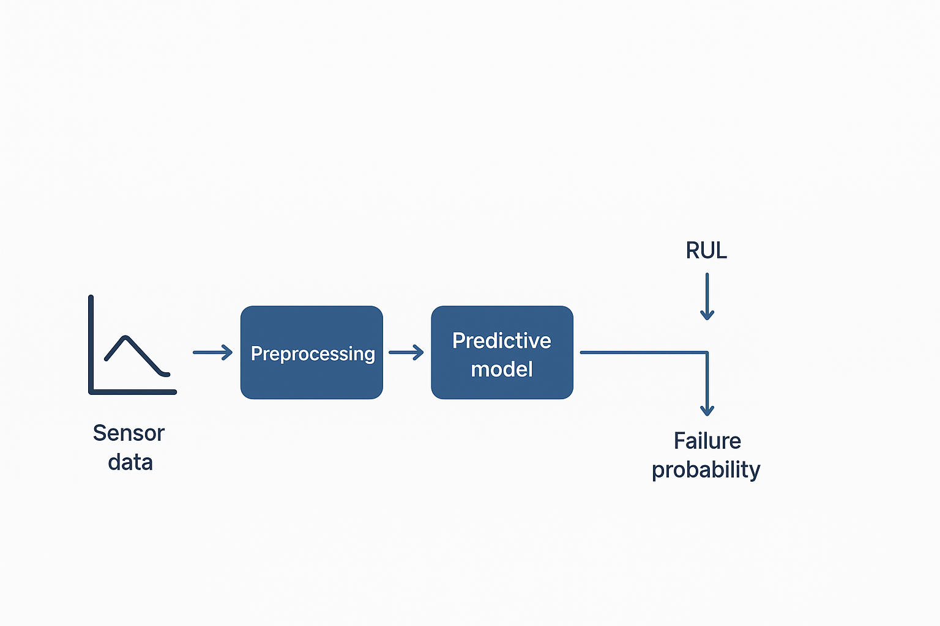
Data Flow Diagram - Level 1
Detailed flow:
1. Raw Data → Cleaning & Feature Engineering
2. Data Split → Training & Testing
3. Model Selection & Tuning
4. Predictions integrated into Power BI dashboards
5. Maintenance decisions generated.

Slide 8
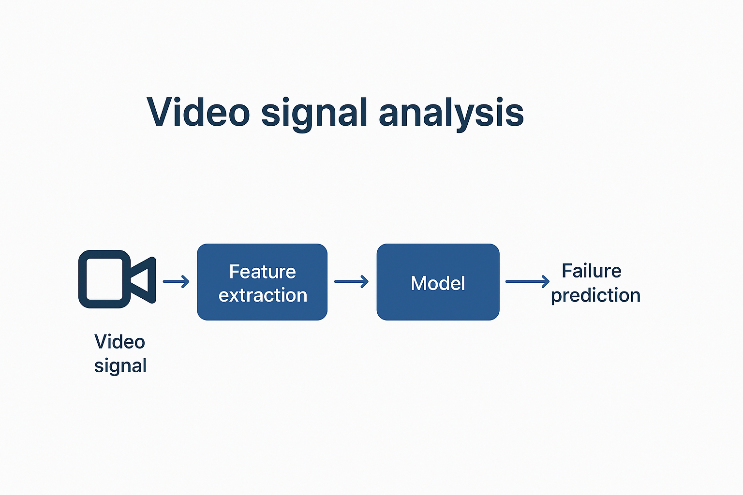
Existing System
Current industry practices:
- Preventive Maintenance (fixed schedule).
- Corrective Maintenance (repair after failure).
Limitations: High costs, unexpected downtime, inefficient scheduling.

Slide 9
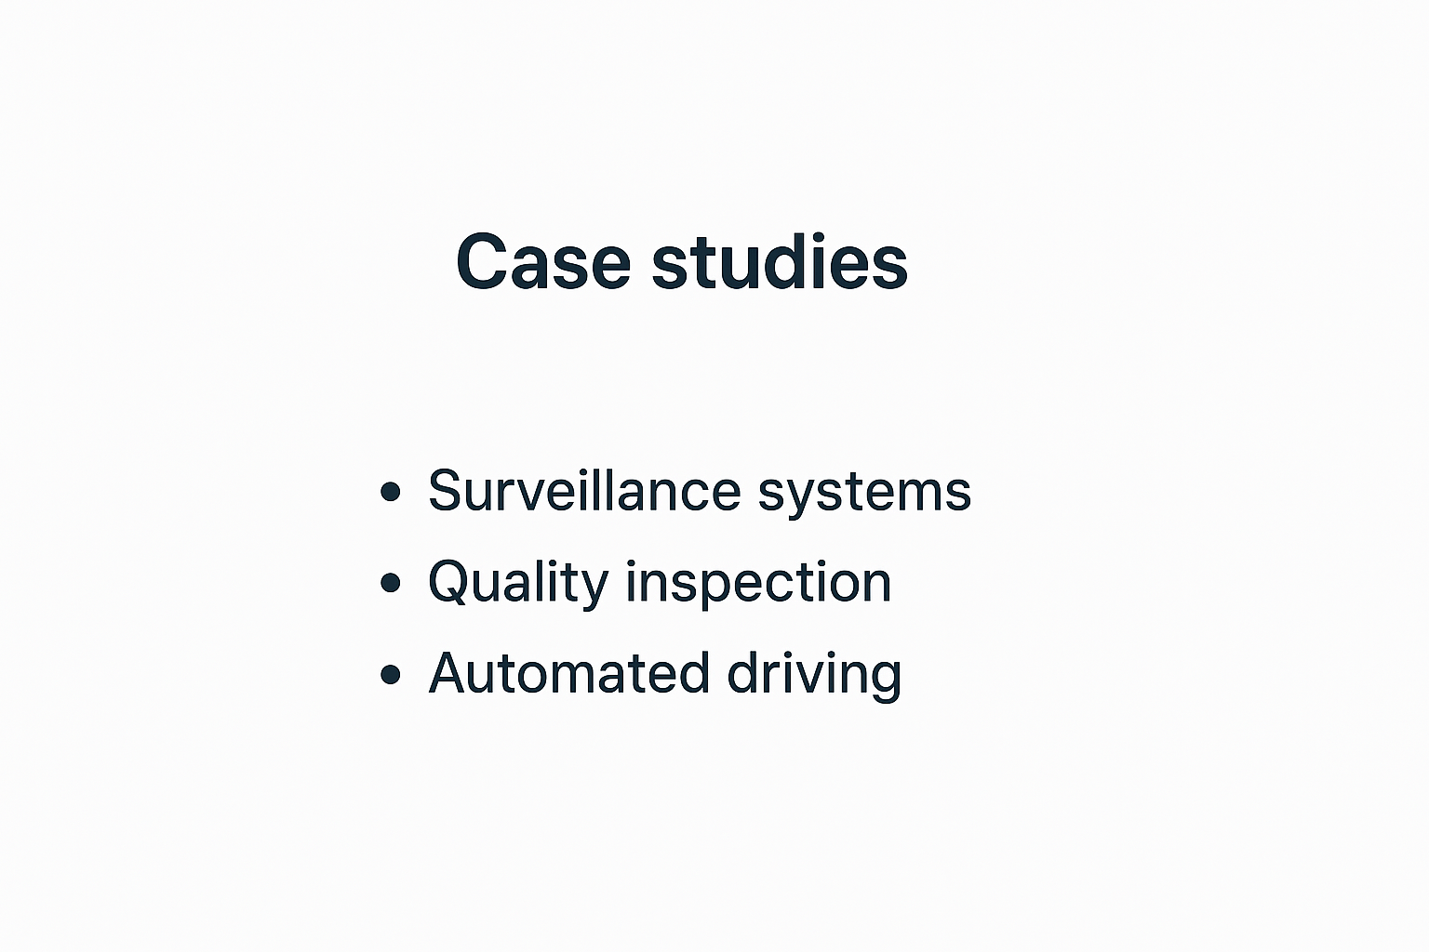
Proposed System
Our PdM system proposes:
- Real-time monitoring via ML models.
- Failure classification and RUL estimation.
- Power BI dashboards for visualization.
- Scalable and adaptable framework with higher accuracy and explainability.

Slide 10
Dataset Description
predictive.csv dataset:
- Contains sensor readings and failure labels.
- Attributes include vibration, temperature, pressure, and operational cycles.
- Data preprocessing addressed imbalance using techniques like resampling.

Slide 11
Model Training & Evaluation
Jupyter Notebook experiments:
- Data split into training and test sets.
- Models compared (RF, XGBoost, ANN).
- Evaluation metrics: Accuracy, F1-score, Precision, Recall.
- Randomforest showed best balance between speed and accuracy.

Slide 12
Results & Analysis
Findings:
- Improved fault detection and prediction accuracy.
- Reduction in downtime compared to traditional methods.
- Power BI visualizations provide actionable insights on failure distribution, trends, and RUL estimation.
- Noted challenge: class imbalance in dataset.

Slide 13
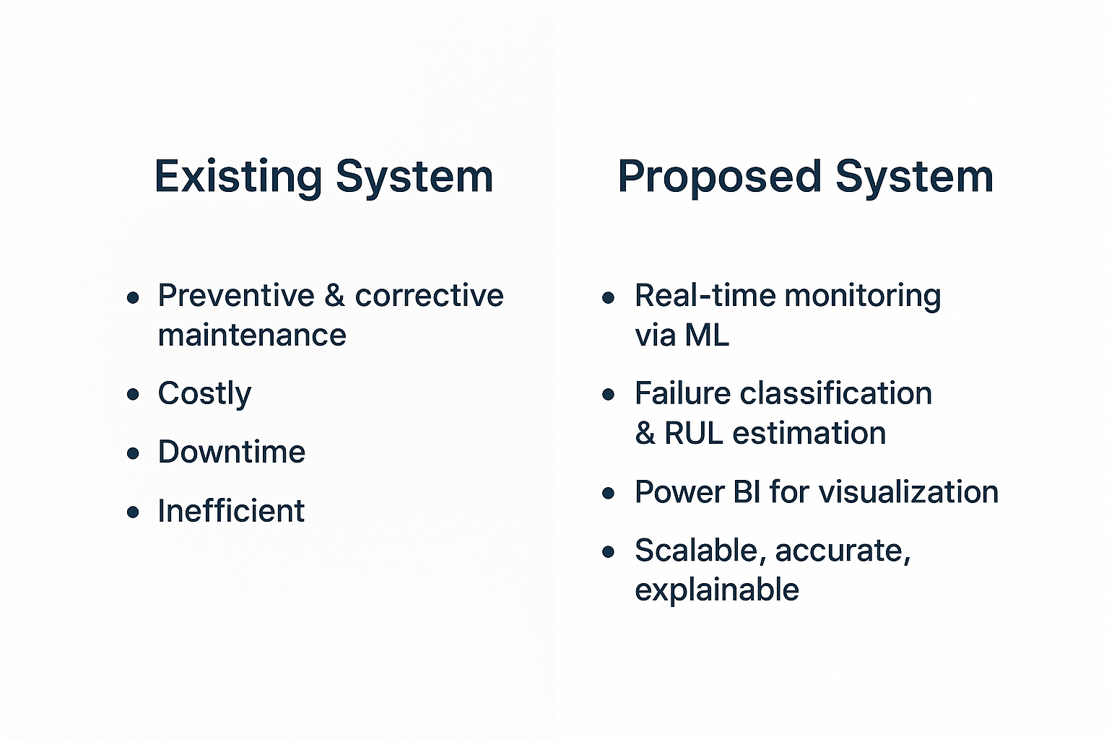
Comparison with Existing Work
Compared with reviewed literature:
- Our system aligns with trends like hybrid ML and digital twins.
- Achieved accuracy >90%, consistent with top studies in manufacturing.
- Improved interpretability using feature importance and SHAP values.

Slide 14
Conclusion
Conclusions:
- ML-based PdM reduces costs and downtime.
- Ensemble models (RF, XGBoost) and DL architectures (LSTM, CNN) are highly effective.
- Integration with Power BI ensures industry applicability.

Slide 15
Future Scope
Future work includes:
- Integration of digital twins for real-time simulation.
- Deployment on cloud-edge architectures.
- Use of federated learning for cross-industry data sharing.
- Enhanced explainable AI for technician trust.

Slide 16
References
Key references:
- Tsallis, C. et al. (2025). Application-Wise Review of ML-Based Predictive Maintenance, Appl. Sci.
- NASA CMAPSS, MIMII, SECOM,AI4I Pdm Milling datasets.
- Experiments on predictive.csv dataset and accompanying Jupyter notebook.
- Power BI dashboards for visualization.

Slide 17
Power BI Dashboard Insights
The Power BI report integrates ML predictions with business insights:
- Interactive dashboards displaying equipment health status.
- Trends in sensor readings over time.
- RUL predictions visualized for quick decision-making.
- Helps management prioritize maintenance tasks.

Slide 18
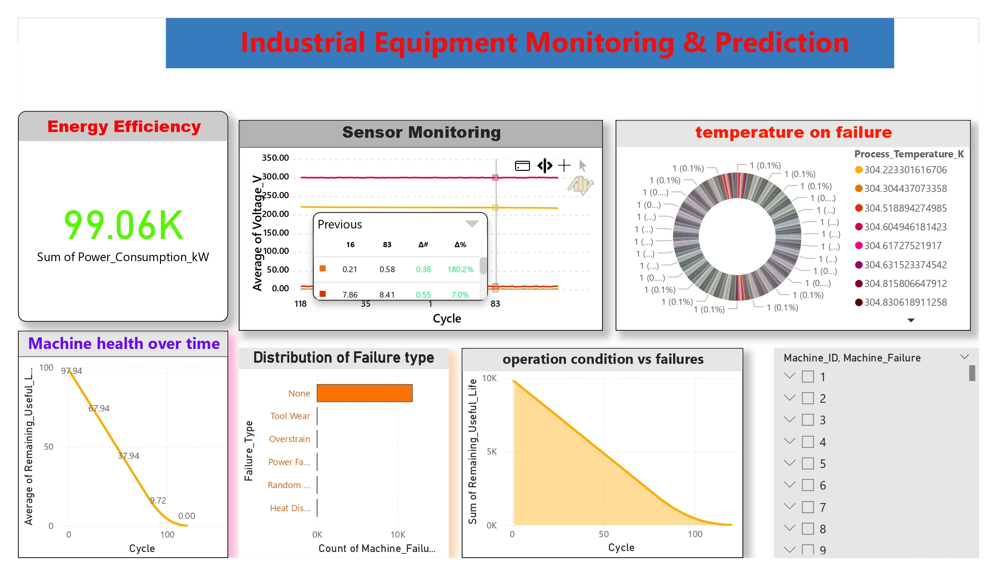

Slide 19
Challenges Faced
Challenges during implementation:
- Data imbalance between failure and non-failure cases.
- Noise in sensor readings affecting accuracy.
- Need for explainability in ML predictions.
- Integration of real-time streaming data remains a bottleneck.

Slide 20
Applications in Industry
PdM Applications across sectors:
- Manufacturing: Rotating machinery, bearings, compressors.
- Automotive: Engines, batteries, suspension systems.
- Energy: Wind turbines, transformers, power plants.
- Healthcare: Medical device reliability monitoring.

